Slide 1
Lecture 32: Handling Exceptions
CSC111: Introduction to CS through Programming
R. Jordan Crouser
Assistant Professor of Computer Science
Smith College

Slide 2
Announcements 1/3
Additional office hours this week:
Wednesday from 2 to 4
Friday (today) from 1:30 to 3
(16 to 0 for talking about projects instead of the midterm)

Slide 3
Announcements 2/3
TODAY!

Slide 4
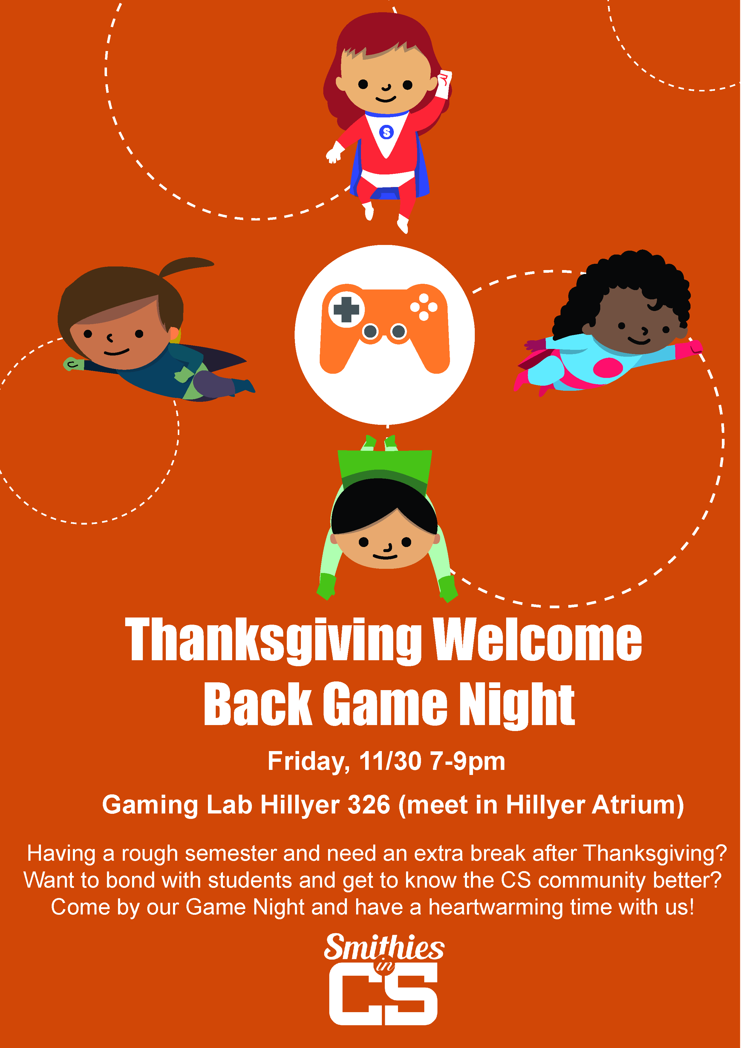
Announcements 3/3
TONIGHT!

Slide 5
Coming up
Announcements
Final Project Proposal Recap
Working with files
what is a file?
reading data in
writing data out
Intro to Algorithms
Recap of Lab: Sorting
Handling Exceptions
Final Project Workshop

Slide 6

Discussion
What part of Lab 10 was
the most challenging?

Slide 7
Takeaways from Lab 10
Algorithmic thinking is hard on multiple levels
Figuring out how to describe the process
Translating that process into code
Recognizing when the code isn’t doing what you want
Evaluating efficiency
…and much more…
Yesterday was just a small taste (it’s okay if you didn’t finish)
Many more opportunities to master this skill, will be a recurring theme in future courses
CSC212
CSC250
CSC252

Slide 8
Coming up
Announcements
Final Project Proposal Recap
Working with files
what is a file?
reading data in
writing data out
Intro to Algorithms
Recap of Lab: Sorting
Handling Exceptions
Final Project Workshop

Slide 9
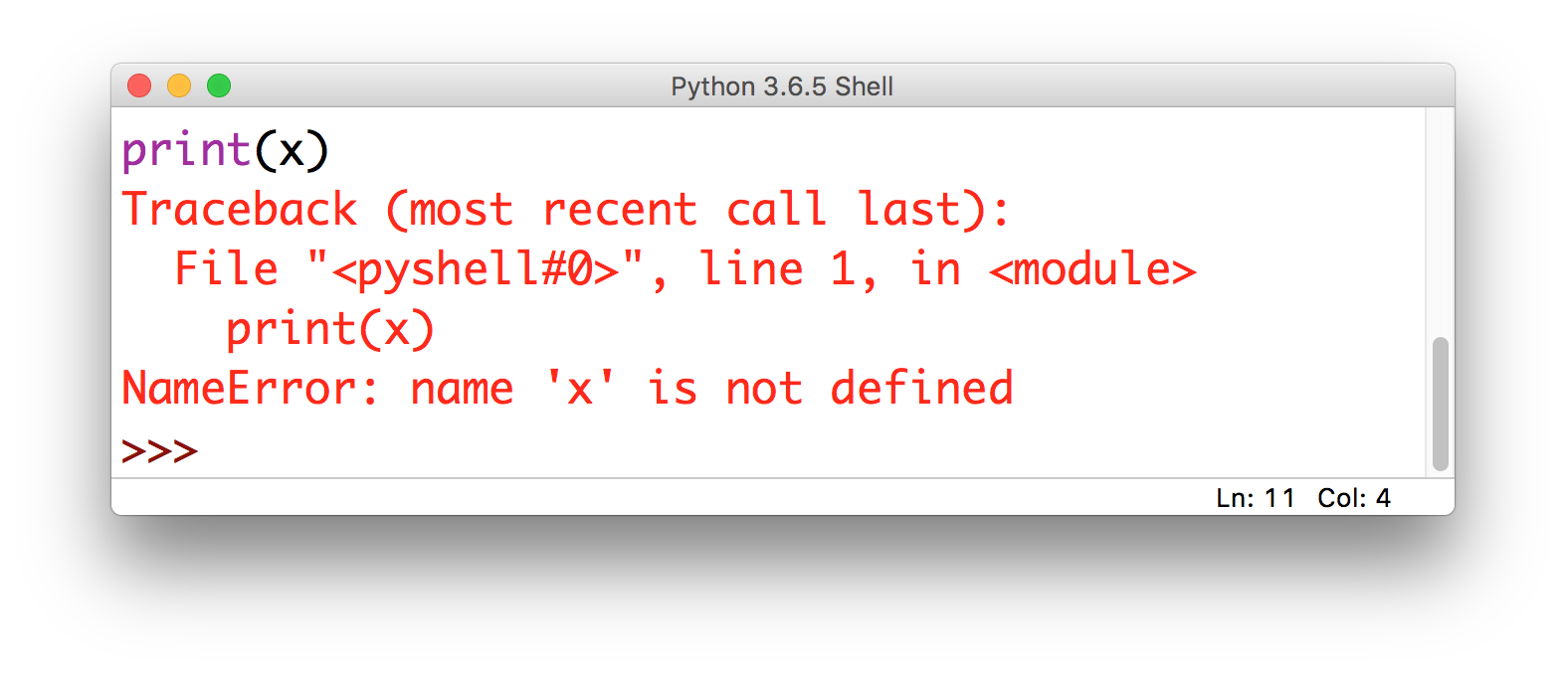
Lecture 10: some problems are obvious
this is called
an Exception

Slide 10
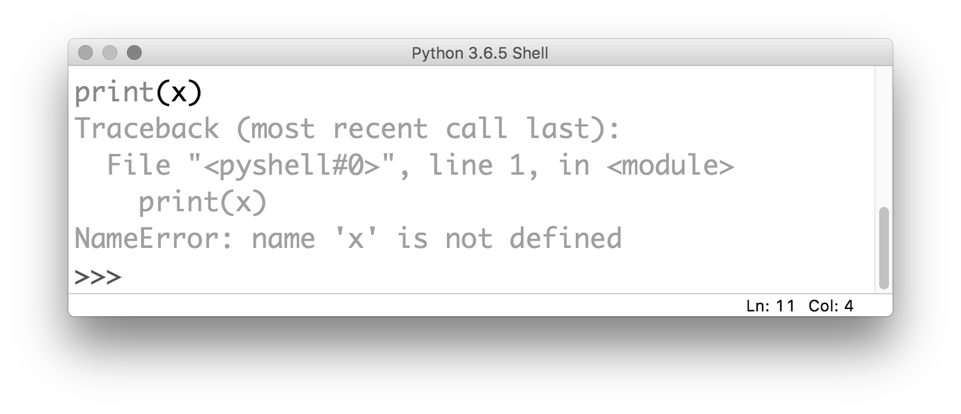
Lecture 10: some problems are obvious
the kind of error gives you
a clue about what the problem is

Slide 11
Lecture 10: some problems are obvious
it also tells you where the problem is
(but be careful!)

Slide 12
Discussion
But there’s a drawback to when your
program throws an Exception…
Notes:
It stops! As of right now, we don’t have any way to recover

Slide 13
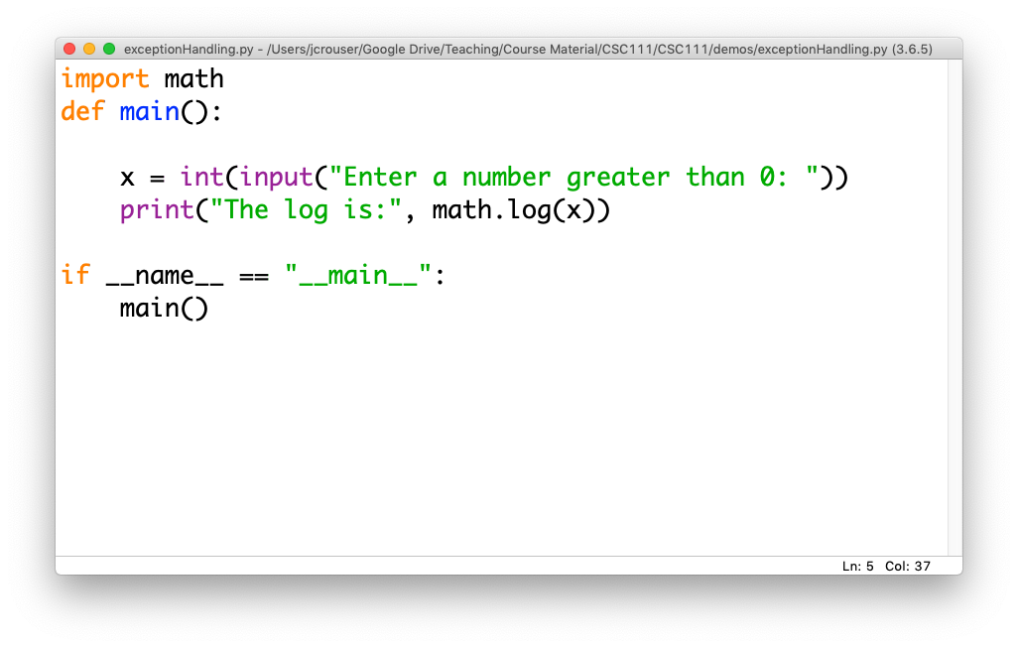
An example
What happens if the user enters
a negative number?

Slide 14
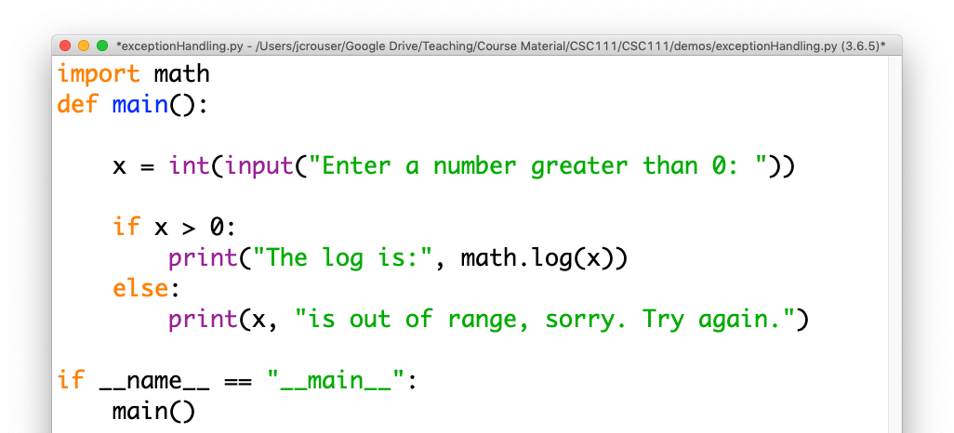
An example
What happens if the
user enters a string?

Slide 15
The try...except block
There are some cases where avoiding an Exception isn’t possible
In this case, we want tell Python:
what we want to happen
how to handle it if things go wrong

Slide 16
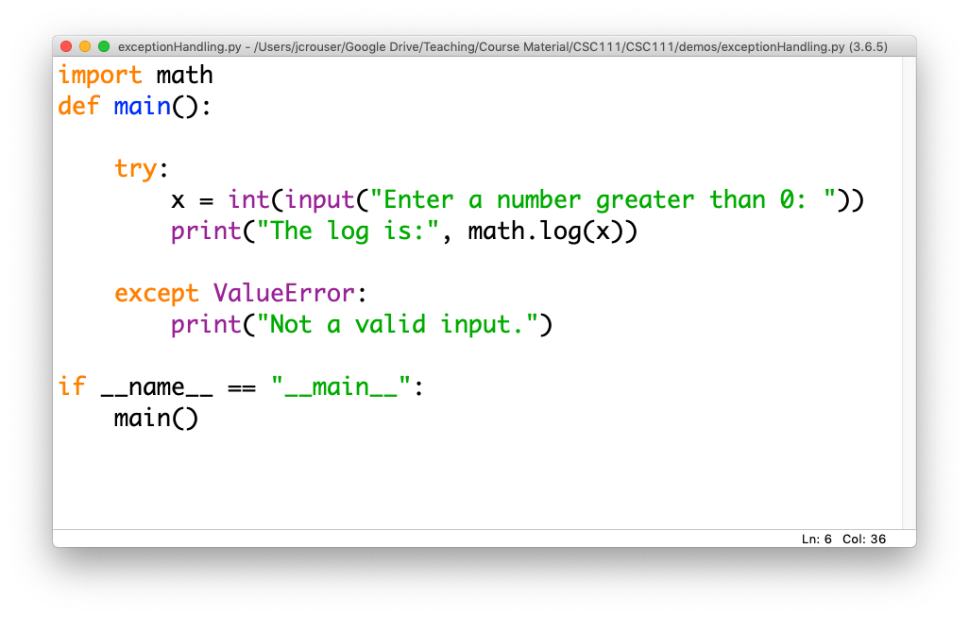
An example

Slide 17
Takeaways
Even if you can’t avoid all errors, you can design your program to fail gracefully
You can handle multiple different kinds of Exceptions, and you can handle them differently
Think about edge cases to provide specific feedback about what went wrong

